Slide 1

Create Interactive Data Visualizations for Clinical Data Review Using Base SAS and JavaScript
Raj Kiran Boddu, Takeda

Slide 2





Slide 3

Risk based monitoring and remote site monitoring
Identification of safety signals in large amounts of data
Identification of data issues
Identification of covariates and feature analysis for modelling
Sharing results with stakeholders

Slide 4


Interactive Data Visualization
“interactive data visualization enables direct actions on a plot to change elements and link between multiple plots”

Slide 5


Slide 6






Slide 7

Overview of Methodology

Slide 8
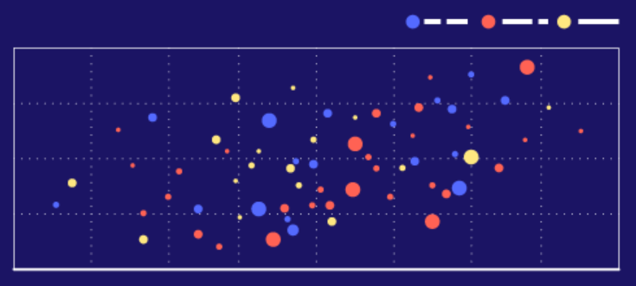

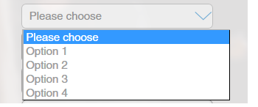
Graphic 2
- | - | - | - | -
---- | ---- | ---- | ---- | ----
Updates based on results from the query.
Query
Query Results
Data Source
Graphic 1 (Source)
A query is generated on selection of some points.
Graphic 2
Updates based on results from the query.
Query Results
- | - | - | - | -
---- | ---- | ---- | ---- | ----
Updates based on results from the query.
Query
Data Source
Widget
Graphic 1

Slide 9
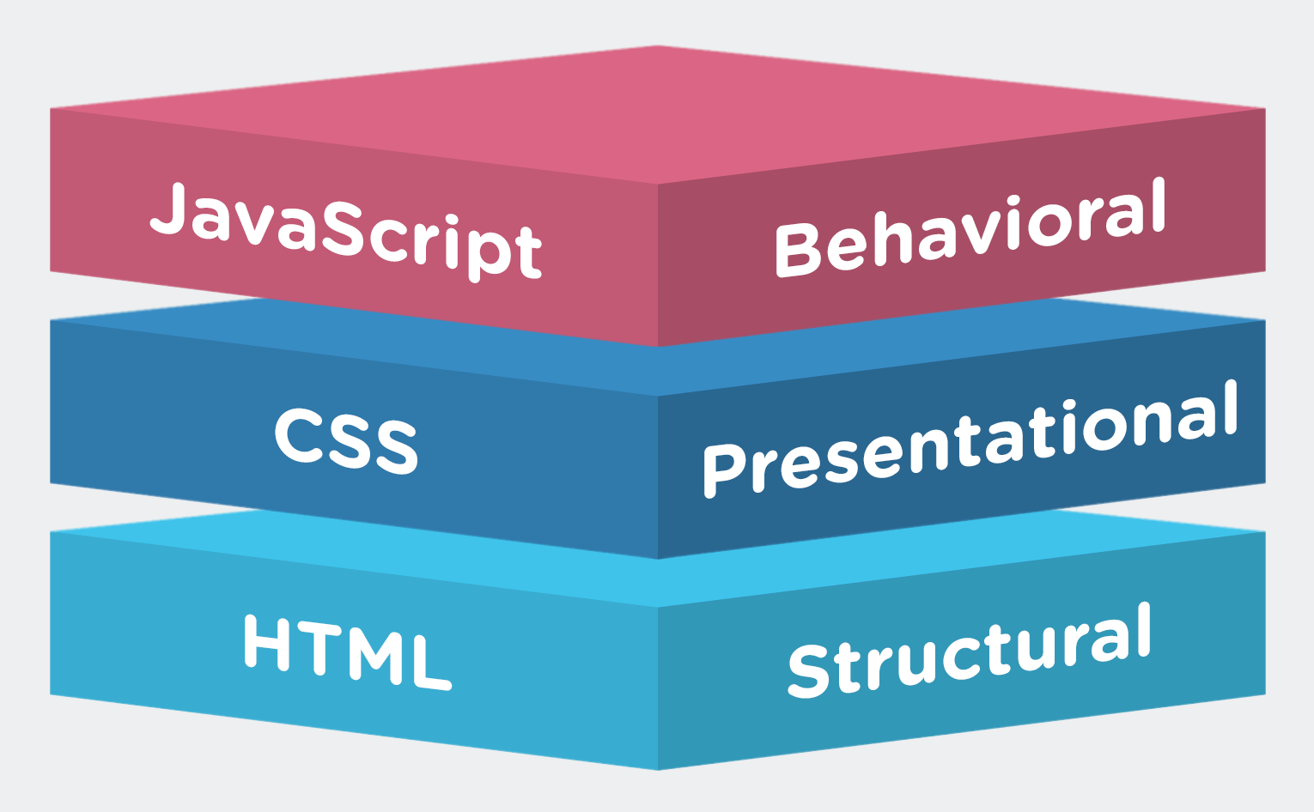

Slide 11
HTML Code
JavaScript Code
Placeholder for Widget
Placeholder for Graphic
HTML code creates the placeholders for widgets and graphics on a HTML page.
JavaScript code creates the widgets and graphics and puts them in the assigned places on the HTML page.
HTML Page

Slide 12
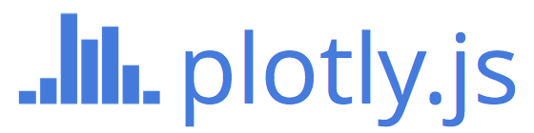
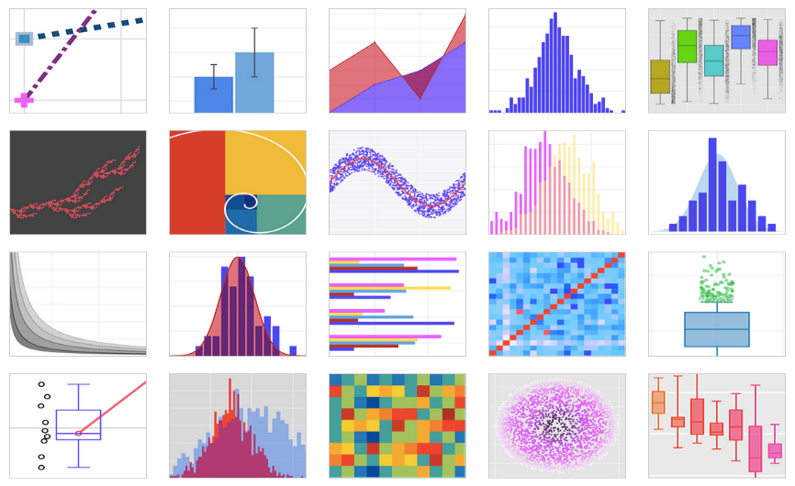
<script src="https://cdn.plot.ly/plotly-latest.min.js"></script>

Slide 13
(X,Y)
(A,B)
≠
(X,Y)
(A,B)

Slide 14

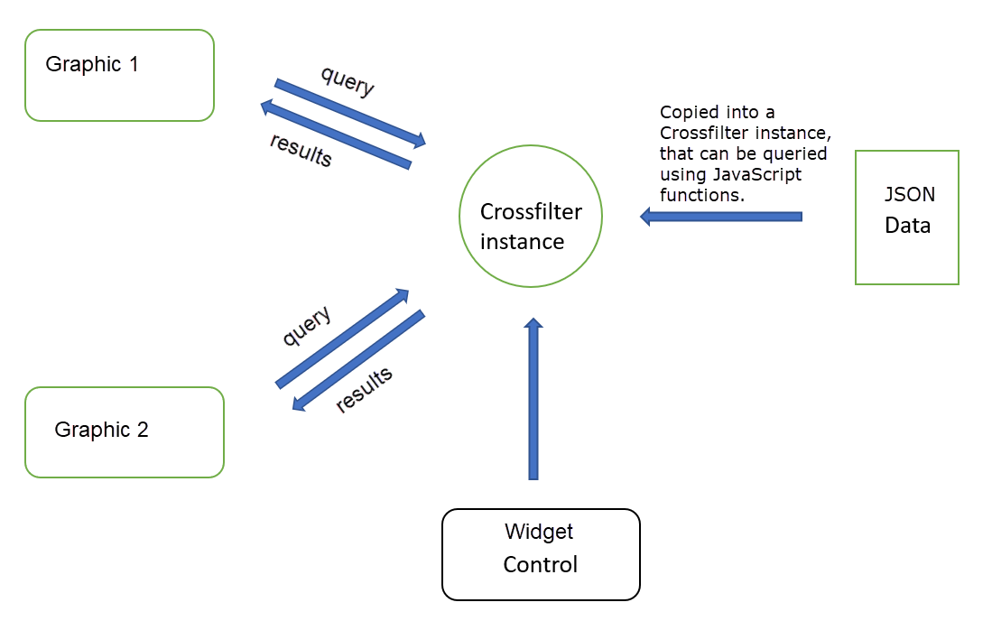
<script src="https://cdnjs.cloudflare.com/ajax/libs/crossfilter2/1.4.6/crossfilter.js">
</script>

Slide 15
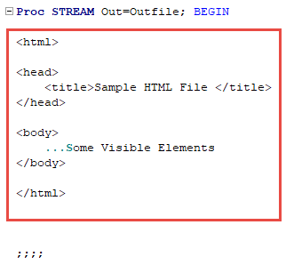
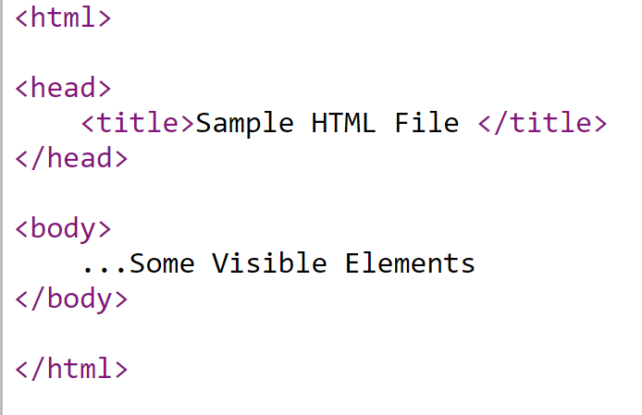
HTML Document

Slide 16
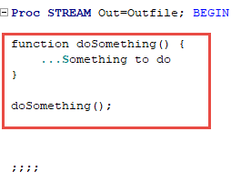
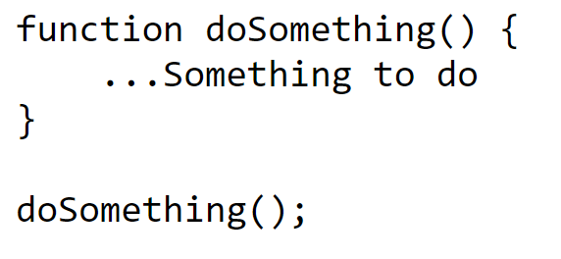
JavaScript Document

Slide 17
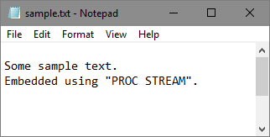
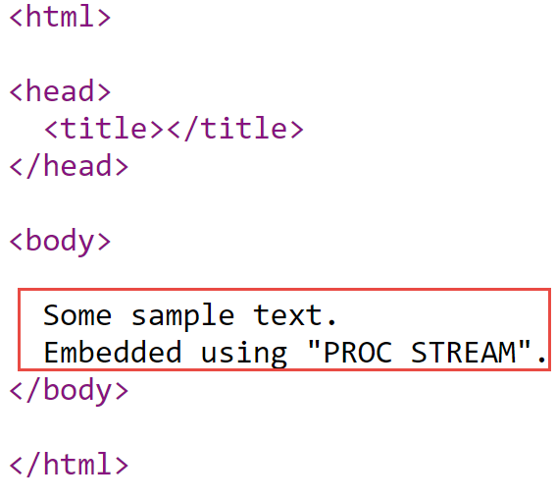
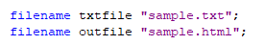
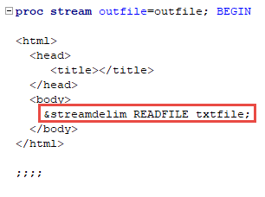
HTML Document

Slide 18
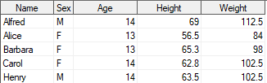
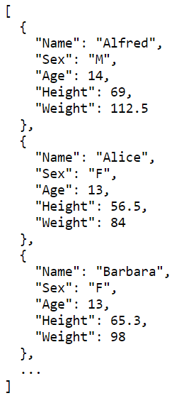
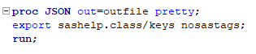
SAS Dataset
JSON Format

Slide 19
MACRO FRAMEWORK

Slide 20
%init
Creates temporary files in SAS session, which are used by other macros.
%data
Writes data to HTML file and creates crossfilter instance for that data.
HTML code: Creates placeholder for widget.
JS code: Creates the options in the widget.
Controls the filtering action using Crossfilter.js
%filters
HTML code: Creates placeholder for scatterplot.
JS code: Creates the scatterplot using Plotly.js.
Controls the filtering action using Crossfilter.js
%scatter
%compile
Stiches together all the temporary files and creates one HTML document.

Slide 21
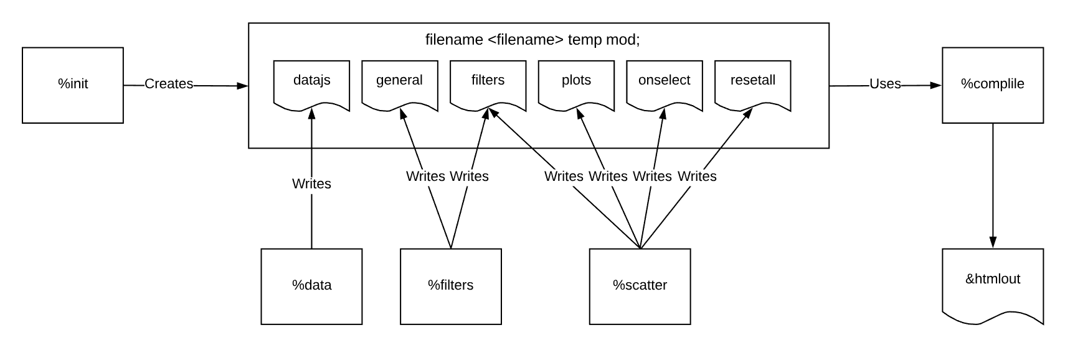

Slide 22
EXAMPLES

Slide 23

DEMO 1

Slide 24
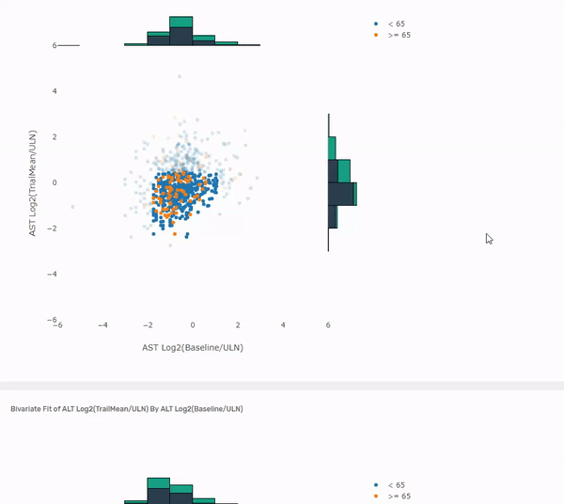

Slide 25
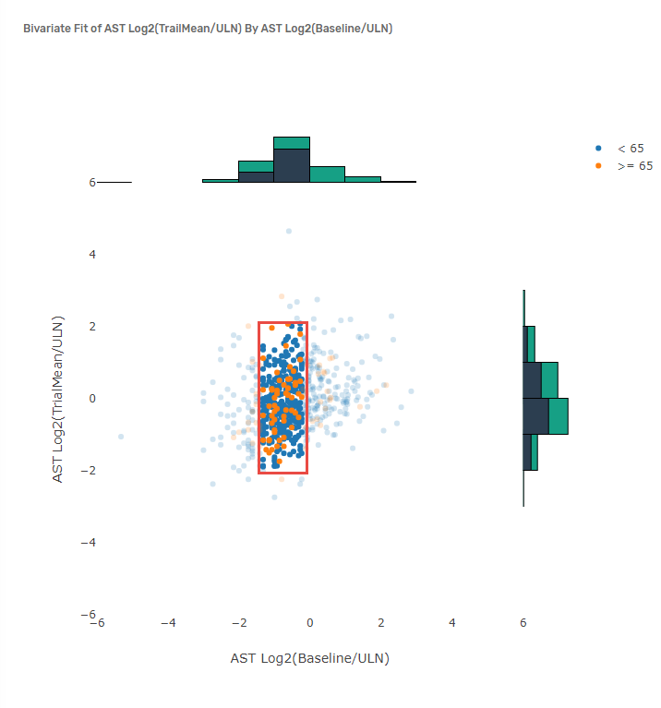
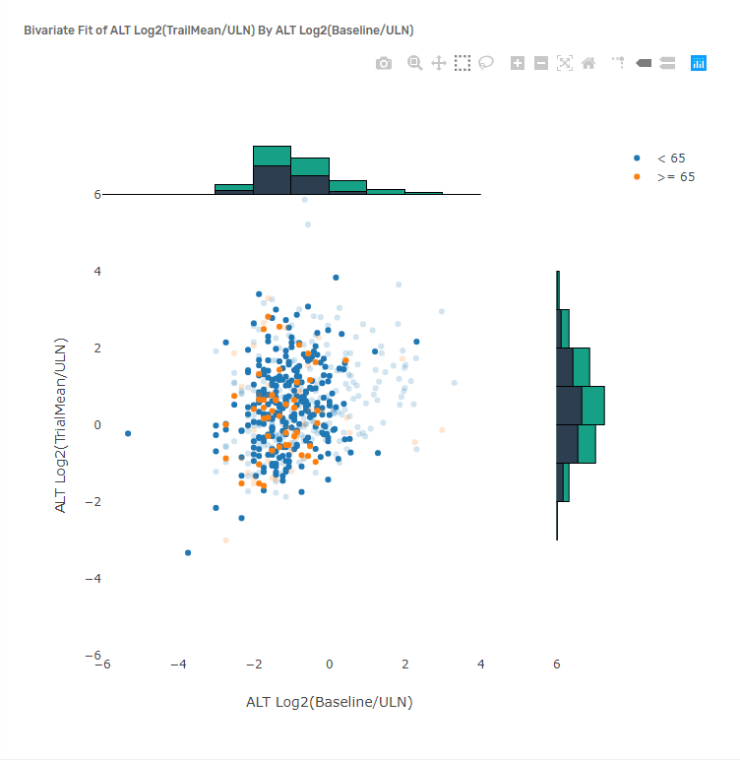

Slide 26
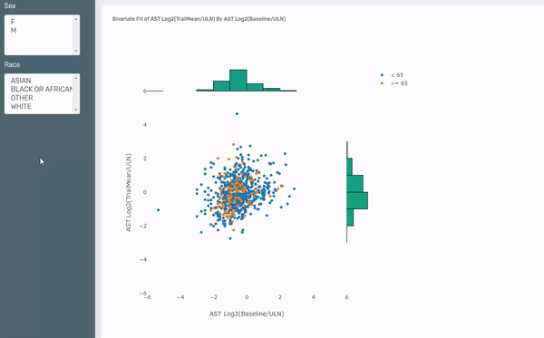

Slide 27
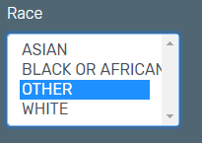
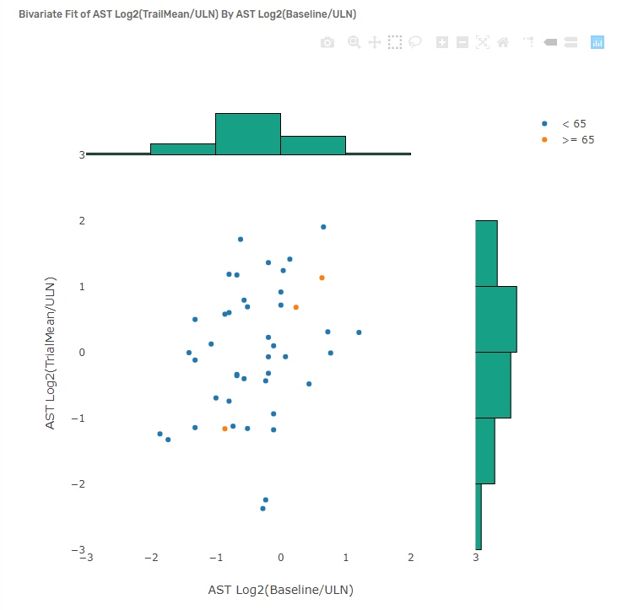
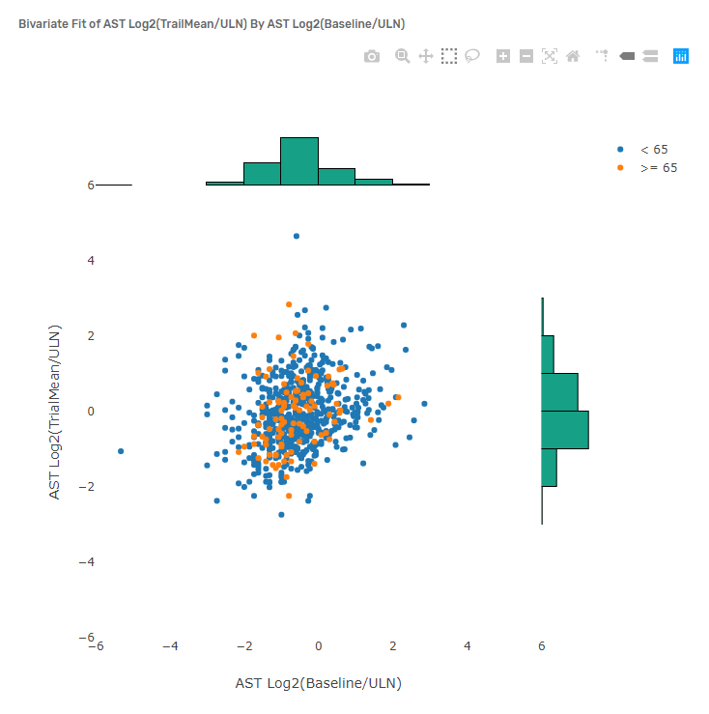
Send query results to graphic
Update graphic to show only results from query.

Slide 28
NAME | LABEL
AGEGR1 | Age Group 1
ALT_Log2_Baseline_ULN_ | ALT Log2(Baseline/ULN)
ALT_Log2_TrialMean_ULN_ | ALT Log2(TrialMean/ULN)
AST_Log2_Baseline_ULN_ | AST Log2(Baseline/ULN)
AST_Log2_TrialMean_ULN_ | AST Log2(TrialMean/ULN)
RACE | Race
SEX | Sex
USUBJID | Unique Subject Identifier
data findings;
set psug.Findings_Shift_Plots;
run;
%init;
%data(findings);
%filters(data=findings,vars=SEX RACE);
%scatter(name=alt,data=findings,x=alt_log2_baseline_uln_,
y=alt_log2_trialmean_uln_,color=AGEGR1,hist=y);
%scatter(name=ast,data=findings,x=ast_log2_baseline_uln_,
y=ast_log2_trialmean_uln_,color=AGEGR1,hist=y);
%compile(htmlout=findings_shift_plot.html,
title=Findings Shift Plots);

Slide 29
DEMO 2

Slide 30
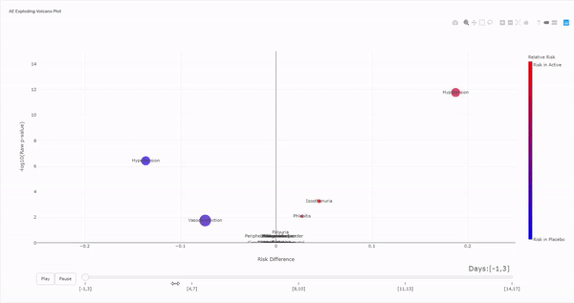

Slide 31
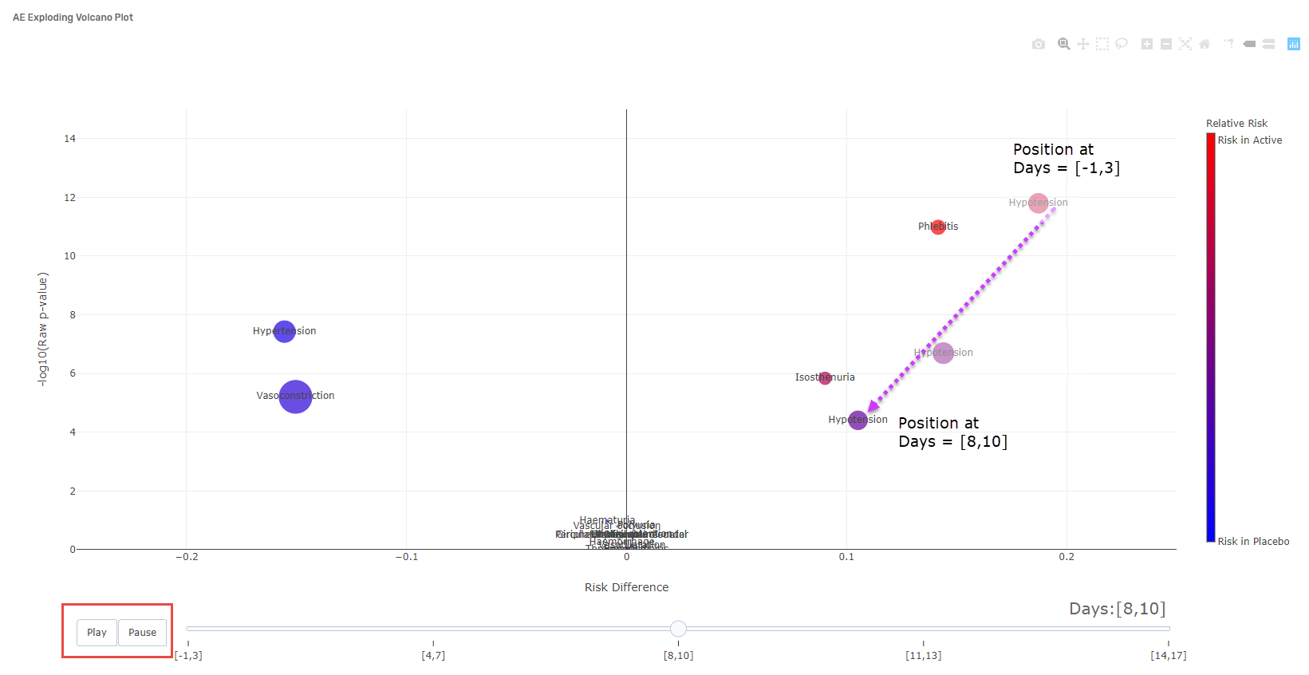

Slide 32
NAME | LABEL
AEBODSYS | Body System or Organ Class
Count | Number of subjects
NegLog10_Raw_p | -log10(Raw p-value)
RR | Relative Risk
RiskDiff | Risk Difference
TimeWindowNum | Time Window based on Study Days
data AE;
set psug.AE_Incidence;
run;
%init;
%data(AE);
%scatter(name=aevolcano,data=AE,x=RiskDiff,y=NegLog10_Raw_p,color=RR,
size=Count,frames=TimeWindowNum,ID=AEDECOD);
%compile(htmlout=aeincidence.html,title=AE Volcano Plot);

Slide 33
CONCLUSION

Slide 34

Advantages
Modular
Sharable without using expensive software
Run close to the Source Data
Securing Data
Extensibility
Other types of charts
Build a library of Interactive Graphics (like JMP Clinical)
Use other JavaScript Charting libraries
Use of SAS Web-based technologies to interactively write the macro code
Code and Examples available at https://rajkboddu.github.io/PharmaSUG2019.html.
Final Thoughts

Slide 35
REFERENCES
Plotly JavaScript Graphing Library. Accessed April 29, 2019. https://plot.ly/javascript/.
Square, Inc. “Crossfilter.” Accessed April 29, 2019. https://square.github.io/crossfilter/.
SAS Institute Inc. “SAS® Help Center: Syntax: PROC STREAM.” Accessed April 29, 2019. https://go.documentation.sas.com/?docsetId=proc&docsetTarget=p06pqn7v5nkz02n0zkpq7832j1yp.htm&docsetVersion=9.4&locale=en.
SAS Institute Inc. “SAS® Help Center: Syntax: PROC JSON.” Accessed April 29, 2019. https://documentation.sas.com/?docsetId=proc&docsetTarget=p06hstivs0b3hsn1cb4zclxukkut.htm&docsetVersion=9.4&locale=en.
SAS Institute Inc. “Clinical Data Analysis Software | JMP Clinical.” Accessed April 29, 2019. https://www.jmp.com/en_my/software/clinical-data-analysis-software.html.
SAS Institute Inc. “Findings Shift Plots | JMP Clinical.” Accessed April 29, 2019. https://www.jmp.com/support/downloads/JMPC71_documentation/Content/JMPCUserGuide/OP_C_FI_0003.htm.
SAS Institute Inc. “AE Incidence Screen | JMP Clinical.” Accessed April 29, 2019. https://www.jmp.com/support/downloads/JMPC71_documentation/Content/JMPCUserGuide/OP_C_EV_0004.htm.
“Plotly.js + Crossfilter.js.” Accessed April 29, 2019. https://plotly.github.io/plotly.js-crossfilter.js/.

Slide 36


